Slide 1
Managing Research Data
Survival Skills Series

Slide 2
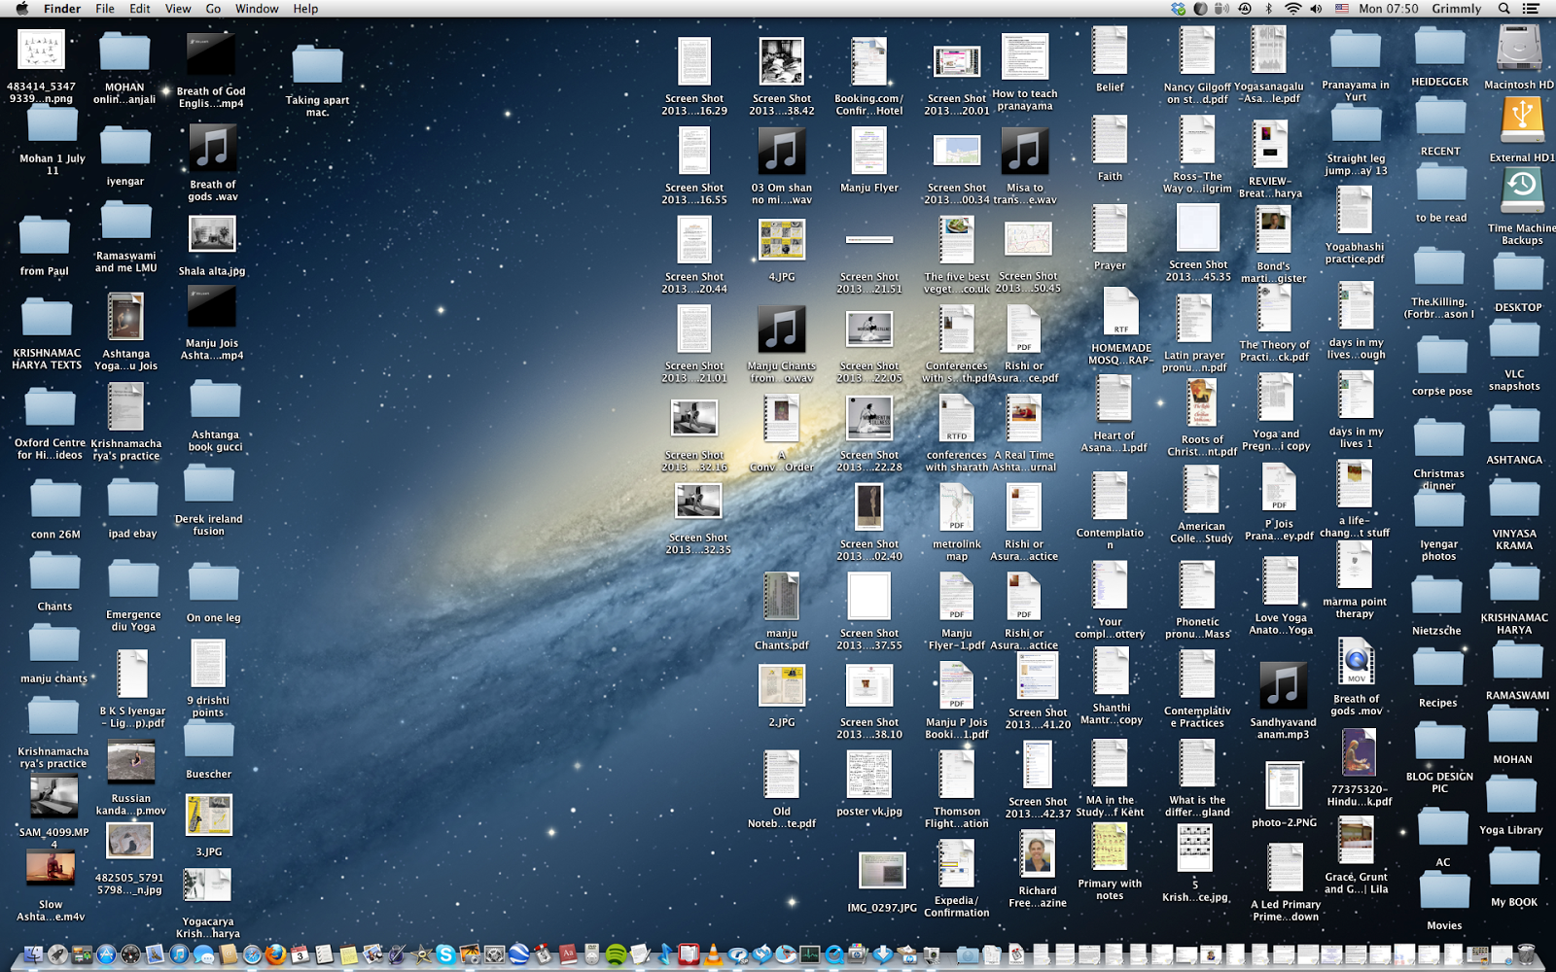
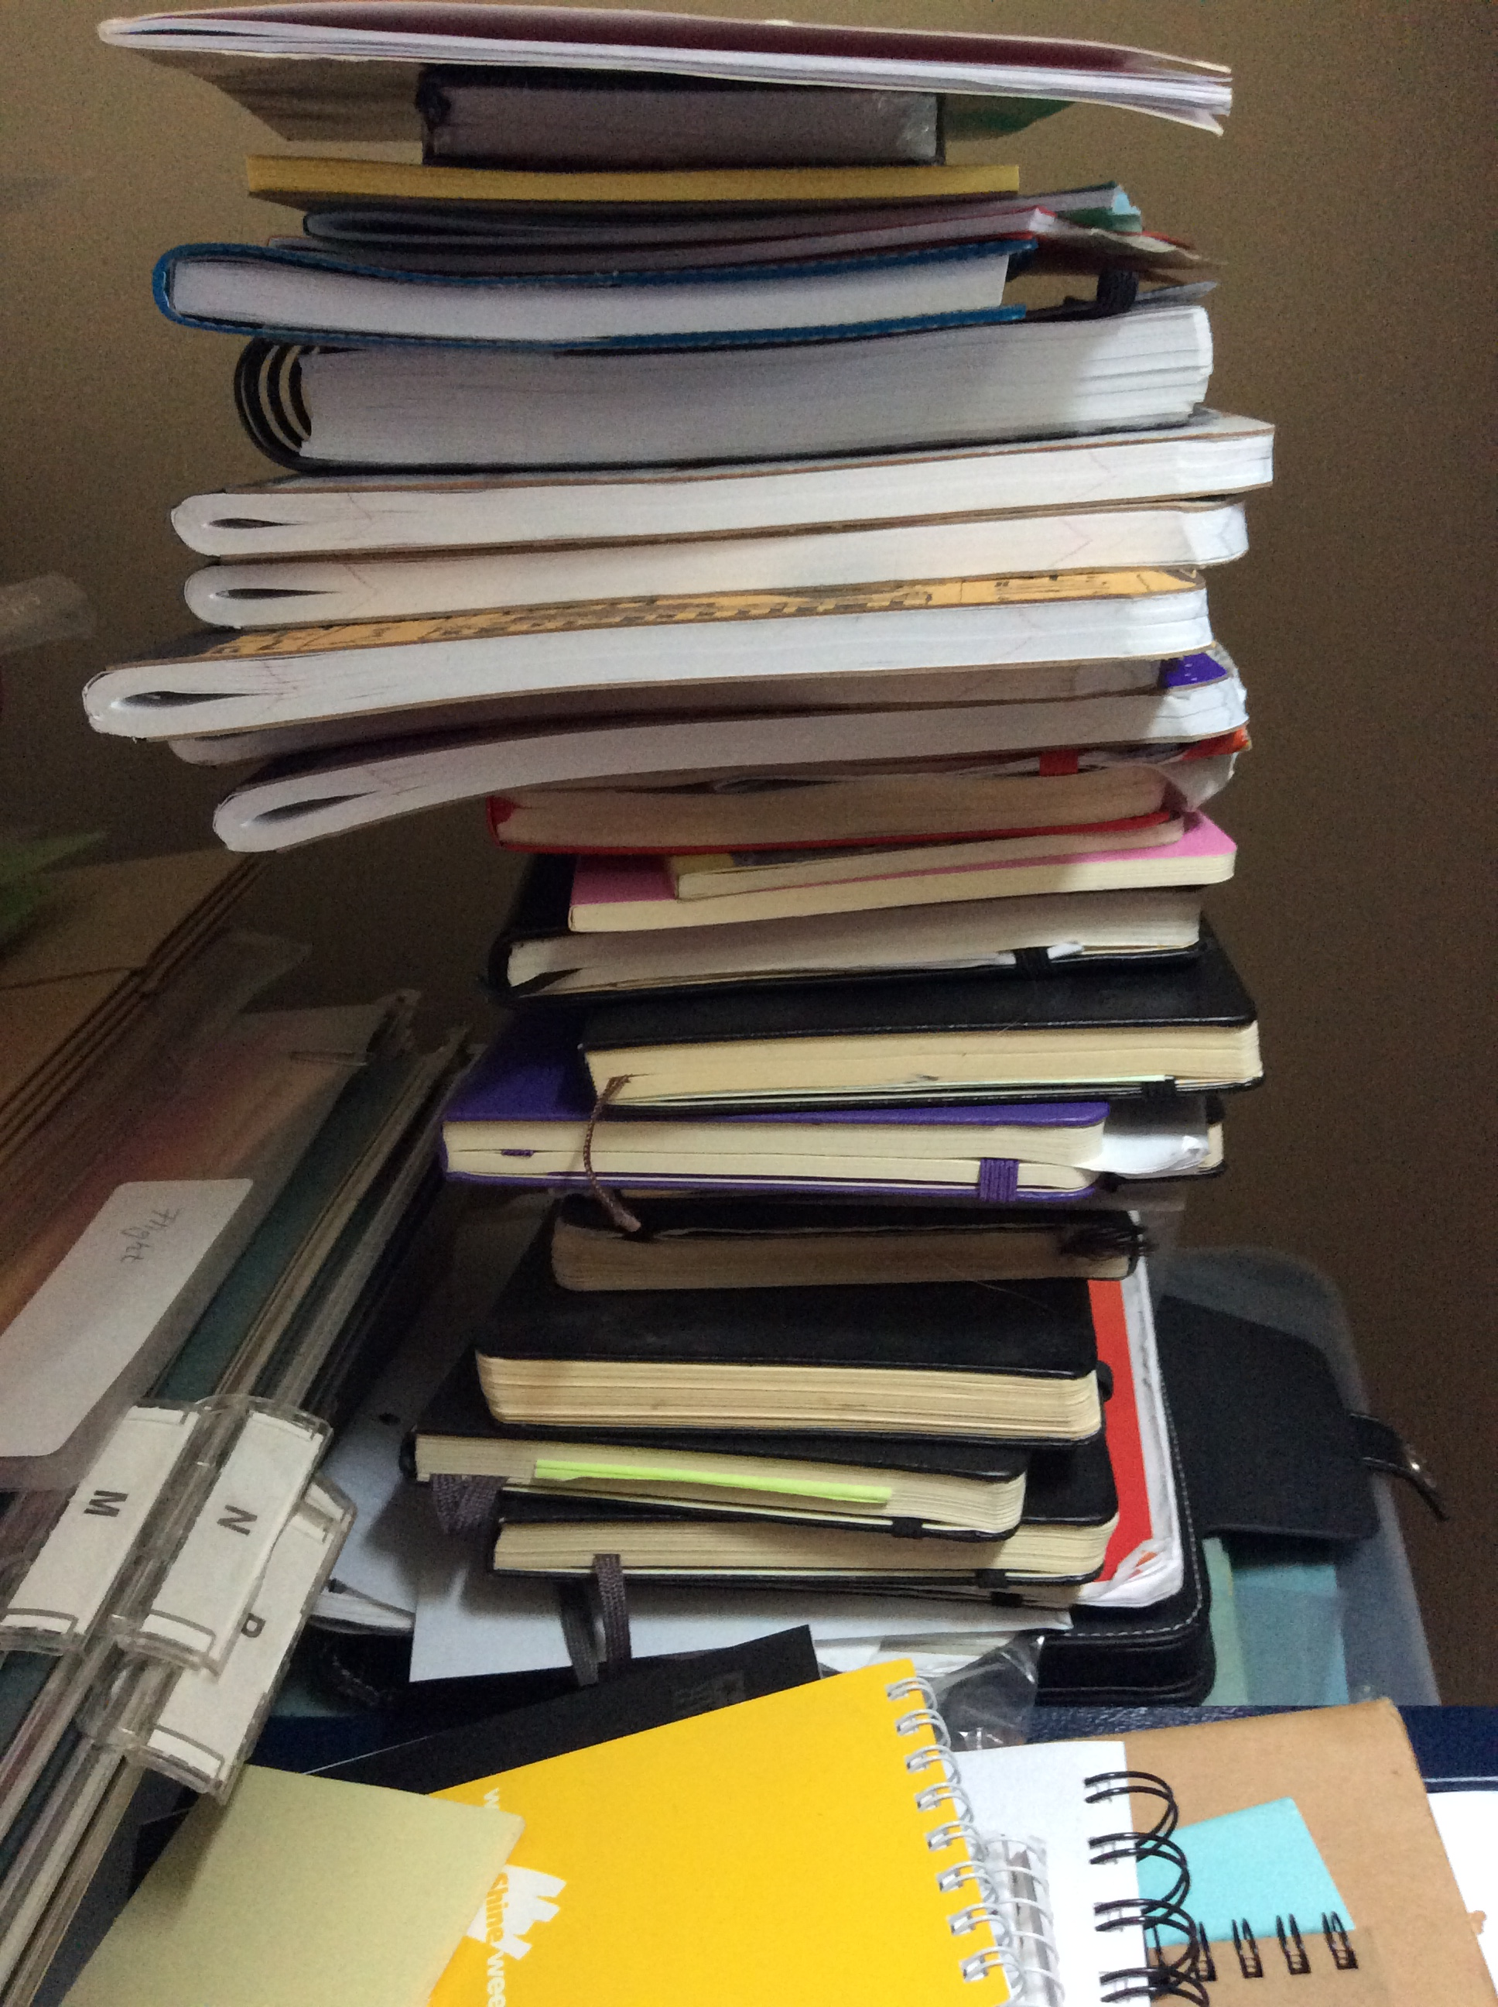

Managing Research Data
Why think about these things?
Discoverability
Others
You
Collaboration
Reproducibility

Slide 3


Amanda’s Research Project
 | 20121103_ra179.7dec12.1_g.fits
 | 20121103_ra179.7dec12.1_r.fits
 | 20121103_ra179.7dec12.1_spec.fits
 | 20121104_ra180.0dec12.1_g.fits
 | 20121104_ra180.0dec12.1_r.fits
 | 20121104_ra180.0dec12.1_spec.fits
 | galaxy1_g_crop.fits
 | galaxy1_r_crop.fits
 | galaxy1_spec_restframe.fits
 | galaxy2_g_crop.fits
 | galaxy2_r_crop.fits
 | galaxy2_spec_restframe.fits
observations
 | 1303.7762.pdf
 | 2dfft.py
 | BHmass.py
 | E&M class notes
 | mass & pitch angle scatter.png
 | paper on mass estimates.pdf
 | redshift(z)histogram
 | results
 | spiral paper.pdf
Notes:
Handouts option – pass out a worksheet with this same representation, ask groups to discuss for a few minutes
ZOOM VIDEO FEED AT BOTTOM LEFT CORNER IN LL123

Slide 4
File Naming
Be descriptive!
Is a date appropriate? YYYYMMDDleafcolor.dat
Are there multiple observers? YYYYMMDD_counts_ABS.csv
Use – or _ or capitalization instead of spaces
this file.docx
ThisFile.docx
this_file.docx
Don’t use special characters like !@#$%^&
File extensions are important (.txt, .csv, .exe)
Be consistent – are there guidelines already in place?
Notes:
The example is high-level nomenclature
http://classic.sdss.org/dr6/dm/flatFiles/spSpec.html
https://www.sdss.org/dr14/manga/manga-data/data-model/
Long file names, nested folders (long path) can cause problems with certain tools like command line

Slide 5
File Naming
Be descriptive!
Is a date appropriate? YYYYMMDDleafcolor.dat
Are there multiple observers? YYYYMMDD_counts_ABS.csv
Use – or _ or capitalization instead of spaces
this file.docx
ThisFile.docx
this_file.docx
Don’t use special characters like !@#$%^&
File extensions are important (.txt, .csv, .exe)
Be consistent – are there guidelines already in place?
Notes:
The example is high-level nomenclature
http://classic.sdss.org/dr6/dm/flatFiles/spSpec.html
https://www.sdss.org/dr14/manga/manga-data/data-model/
Long file names, nested folders (long path) can cause problems with certain tools like command line

Slide 6
File Naming
Be descriptive!
Is a date appropriate? YYYYMMDDleafcolor.dat
Are there multiple observers? YYYYMMDD_counts_ABS.csv
Use – or _ or capitalization instead of spaces
this file.docx
ThisFile.docx
this_file.docx
Don’t use special characters like !@#$%^&
File extensions are important (.txt, .csv, .exe)
Be consistent – are there guidelines already in place?
Notes:
The example is high-level nomenclature
http://classic.sdss.org/dr6/dm/flatFiles/spSpec.html
https://www.sdss.org/dr14/manga/manga-data/data-model/
Long file names, nested folders (long path) can cause problems with certain tools like command line

Slide 7
File Naming
Be descriptive!
Is a date appropriate? YYYYMMDDleafcolor.dat
Are there multiple observers? YYYYMMDD_counts_ABS.csv
Use – or _ or capitalization instead of spaces
this file.docx
ThisFile.docx
this_file.docx
Don’t use special characters like !@#$%^&
File extensions are important (.txt, .csv, .exe)
Be consistent – are there guidelines already in place?
Notes:
The example is high-level nomenclature
http://classic.sdss.org/dr6/dm/flatFiles/spSpec.html
https://www.sdss.org/dr14/manga/manga-data/data-model/
Long file names, nested folders (long path) can cause problems with certain tools like command line

Slide 8
File Naming
Be descriptive!
Is a date appropriate? YYYYMMDDleafcolor.dat
Are there multiple observers? YYYYMMDD_counts_ABS.csv
Use – or _ or capitalization instead of spaces
this file.docx
ThisFile.docx
this_file.docx
Don’t use special characters like !@#$%^&
File extensions are important (.txt, .csv, .exe)
Be consistent – are there guidelines already in place?
Notes:
The example is high-level nomenclature
http://classic.sdss.org/dr6/dm/flatFiles/spSpec.html
https://www.sdss.org/dr14/manga/manga-data/data-model/
Long file names, nested folders (long path) can cause problems with certain tools like command line

Slide 9
File Naming
Be descriptive!
Is a date appropriate? YYYYMMDDleafcolor.dat
Are there multiple observers? YYYYMMDD_counts_ABS.csv
Use – or _ or capitalization instead of spaces
this file.docx
ThisFile.docx
this_file.docx
Don’t use special characters like !@#$%^&
File extensions are important (.txt, .csv, .exe)
Be consistent – are there guidelines already in place?
Notes:
The example is high-level nomenclature
http://classic.sdss.org/dr6/dm/flatFiles/spSpec.html
https://www.sdss.org/dr14/manga/manga-data/data-model/
Long file names, nested folders (long path) can cause problems with certain tools like command line

Slide 10
File Naming
Be descriptive!
Is a date appropriate? YYYYMMDDleafcolor.dat
Are there multiple observers? YYYYMMDD_counts_ABS.csv
Use – or _ or capitalization instead of spaces
this file.docx
ThisFile.docx
this_file.docx
Don’t use special characters like !@#$%^&
File extensions are important (.txt, .csv, .exe)
Be consistent – are there guidelines already in place?
Notes:
The example is high-level nomenclature
http://classic.sdss.org/dr6/dm/flatFiles/spSpec.html
https://www.sdss.org/dr14/manga/manga-data/data-model/
Long file names, nested folders (long path) can cause problems with certain tools like command line

Slide 11
File Naming
Be descriptive!
Is a date appropriate? YYYYMMDDleafcolor.dat
Are there multiple observers? YYYYMMDD_counts_ABS.csv
Use – or _ or capitalization instead of spaces
this file.docx
ThisFile.docx
this_file.docx
Don’t use special characters like !@#$%^&
File extensions are important (.txt, .csv, .exe)
Be consistent – are there guidelines already in place?
Notes:
The example is high-level nomenclature
http://classic.sdss.org/dr6/dm/flatFiles/spSpec.html
https://www.sdss.org/dr14/manga/manga-data/data-model/
Long file names, nested folders (long path) can cause problems with certain tools like command line

Slide 12
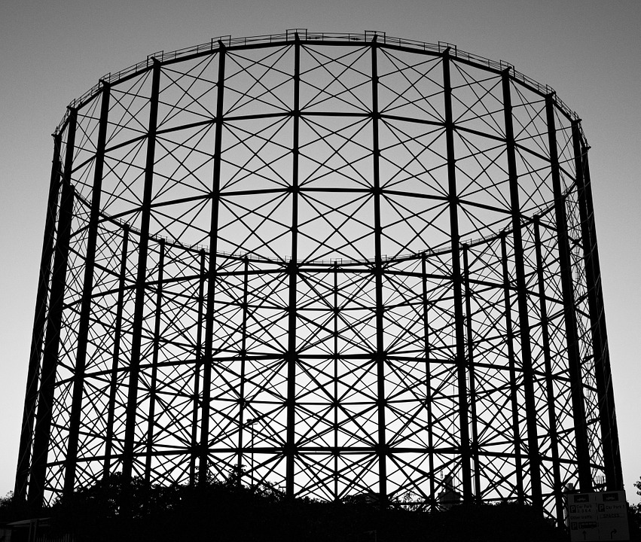
File Organization
new_research_project
data
raw_data
processed_data
analysis
question1
question2
literature
write_up
Notes:
Organization = you can search and find
Being able to share is secondary
For certain projects, dynamically linking, if Excel is your primary tool interaction with your data

Slide 13
README files
Create README for each file or data set
Write as plain text file
Information to include:
https://libraries.ou.edu/content/how-make-readmetxt-file
Notes:
START WITH EXAMPLE - http://cdsarc.u-strasbg.fr/viz-bin/Cat?cat=B%2Fchandra&target=readme&menu=on

Slide 14
README files
Create README for each file or data set
Write as plain text file
Information to include:
https://libraries.ou.edu/content/how-make-readmetxt-file

Slide 15
README files
Create README for each file or data set
Write as plain text file
Information to include:
https://libraries.ou.edu/content/how-make-readmetxt-file

Slide 16
README files
Create README for each file or data set
Write as plain text file
Information to include:
https://libraries.ou.edu/content/how-make-readmetxt-file
Notes:
Go to libraries.ou.edu and search for readme file

Slide 17
Amanda’s Research Project
File Naming
be descriptive
no special characters or spaces
use file extensions
Organize / add structure
Include READMEs
 | 20121103_ra179.7dec12.1_g.fits
 | 20121103_ra179.7dec12.1_r.fits
 | 20121103_ra179.7dec12.1_spec.fits
 | 20121104_ra180.0dec12.1_g.fits
 | 20121104_ra180.0dec12.1_r.fits
 | 20121104_ra180.0dec12.1_spec.fits
 | galaxy1_g_crop.fits
 | galaxy1_r_crop.fits
 | galaxy1_spec_restframe.fits
 | galaxy2_g_crop.fits
 | galaxy2_r_crop.fits
 | galaxy2_spec_restframe.fits
observations
 | 1303.7762.pdf
 | 2dfft.py
 | BHmass.py
 | E&M class notes
 | mass & pitch angle scatter.png
 | paper on mass estimates.pdf
 | redshift(z)histogram
 | results
 | spiral paper.pdf
Notes:
Handouts option – pass out a worksheet with this same representation, ask groups to discuss for a few minutes
ZOOM VIDEO FEED AT BOTTOM LEFT CORNER IN LL123

Slide 18
BlackHoleMass_SpiralGalaxy
analysis
plots
 | mass_pitchangle_scatter.png
 | redshift_histogram.png
 | galaxy1_g_crop.fits
 | galaxy1_r_crop.fits
 | galaxy1_spec_restframe.fits
 | galaxy2_g_crop.fits
 | galaxy2_r_crop.fits
 | galaxy2_spec_restframe.fits
 | README.txt
 | README_methods.txt
 | 2dfft.py
 | BHmass.py
 | results.csv
 | README.txt
data
processed
 | 20121103_ra179.7dec12.1_g.fits
 | 20121103_ra179.7dec12.1_r.fits
 | 20121103_ra179.7dec12.1_spec.fits
 | 20121104_ra180.0dec12.1_g.fits
 | 20121104_ra180.0dec12.1_r.fits
 | 20121104_ra180.0dec12.1_spec.fits
 | README.txt
raw
 | BHmass_pitch.bib
 | KormandyHo2013.pdf
 | Lusso2010.pdf
 | Vertergaard2006.pdf
literature
 | README.txt

Slide 19
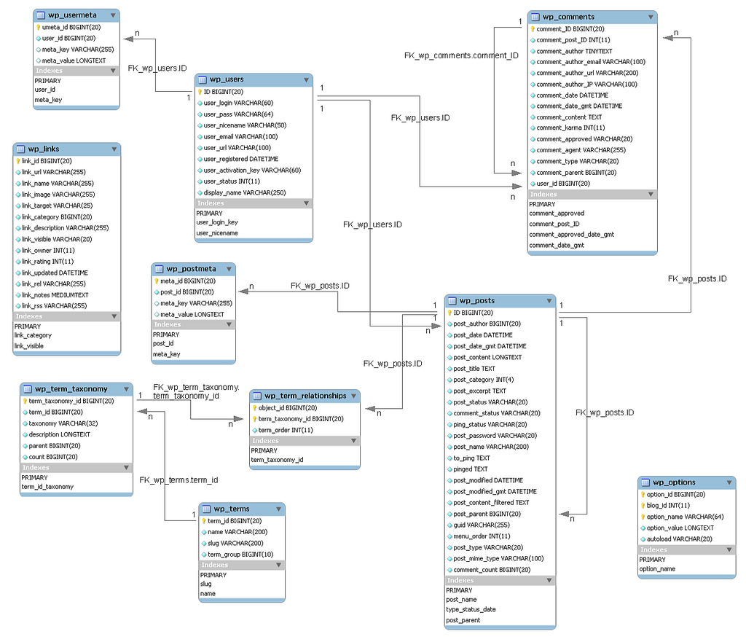
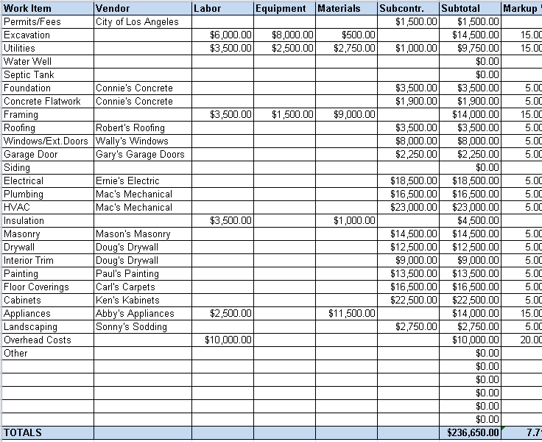
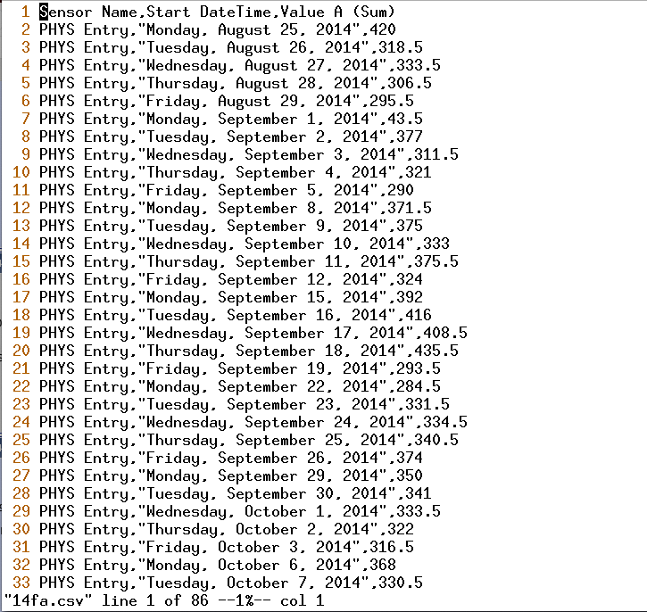




Data organization
Spreadsheets
Flat files (csv/tsv/txt)
Database
Notes:
Spreadsheets are a good place to start
Add comparison to CSV – easy to read, no tabs, imports to most programs, can be connected programming language

Slide 20
Data organization
Spreadsheets
Available software
Edited directly
Quickly analyze, make charts
Notes:
Spreadsheets are a good place to start
Add comparison to CSV – easy to read, no tabs, imports to most programs, can be connected programming language

Slide 21
Data organization
Flat files (csv/tsv/txt)
Read by many programs (including excel)
Programming language to analyze or connect to other tables
Notes:
Spreadsheets are a good place to start
Add comparison to CSV – easy to read, no tabs, imports to most programs, can be connected programming language

Slide 22
Data organization
Database
Relational data
Interact by specific software (multi-user friendly)
Can handle large data sets
Complex searching
Notes:
Spreadsheets are a good place to start
Add comparison to CSV – easy to read, no tabs, imports to most programs, can be connected programming language

Slide 23


More on managing data
Formatting data for analysis - Tidy Data: Fri. March 15, 11am
Version control
Data Management Plans - Mark Laufersweiler, Research Data Specialist; (Data Management Plan Tool for Funding: Fri. March 15, 2pm)
Notes:
Put these on the handout!

Slide 24
Find more resources and upcoming events!
Carpentries two-day workshops https://libraries.ou.edu/ carpentries
Information Specialists @ DAVIS https://libraries.ou.edu/davis
Digital Scholarship Lab https://libraries.ou.edu/dsl

Slide 25
Please take 5 min to help us improve
Survey link
bit.ly/oulib_davis_workshop
Today’s topic
Survival Skills: Managing Research Data

